Slide 1

eDTK – DAD NFT Testing

Slide 2
Agenda
Objective
DAD NFT Plan
Execution Plan
NFT Status
What is been measured?
Challenges

Slide 3
Objective of DADs NFT
Replicate the 2 hour peak time during sales where 5000 order line items would be processed. In the first 3 weeks of June (March, Sept and Dec as well) there will be 30000 order line items processed by customer admin; 60% of these during sales close week.

Slide 4
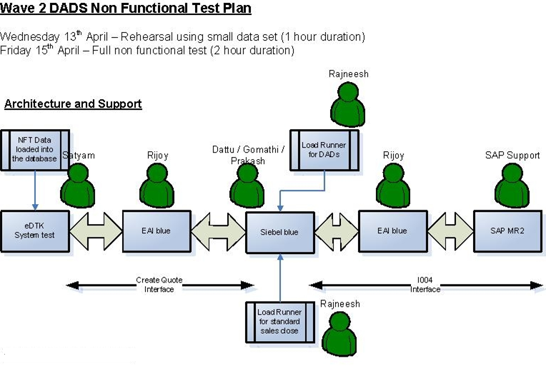
NFT Plan

Slide 5
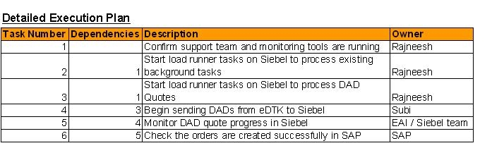
Execution Plan

Slide 6
NFT Status– In Progress
1. We had conducted few rounds of testing with order processing from Siebel Blue – SAP MR2 for an order with 500 line items. During this we had faced issues with EAI, DB and the long time taken to complete the order. This was resolved with some of the workflow changes.
Note: Some background load for the Account Publish, Contact Publish, Quote creation and the Oppty creation is applied during the DAD testing.

Slide 7
What is been measured?
Order Number | Order Journey | Time Taken (SRM Request Table)
1-5360337726 | Order Submission | 37 Seconds
1-5360337726 | Order Processing and Response from downstream system | 18 Mins 3 Seconds
1-5360453551 | Order Submission | 27 Seconds
1-5360453551 | Order Processing and Response from downstream system | 20 Mins 26 Seconds
Request processing | EAI Dequeues Order request from Siebel: |  |  |  |  |  | 11:29:47 AM GMT | 30 sec |  | Total time: Approx < 2 minutes
 | Billing request send to SAP: |  |  |  |  |  | 11:30:17 AM GMT
Response propagation | Received Billing Status from SAP : |  |  |  |  |  | 11:36:18 AM GMT |  | Approx-1 min 20 sec
 | sent the Billing status for OLIs to Siebel |  |  |  |  |  | 11:36:30 AM GMT
 | [Acknowledgement] Received |  |  |  |  |  | 11:37:42 AM GMT

Slide 8
Challenges
Environment issues
Test Data Issues

